Slide 1
Welcome!
Agenda
Who I am
Data Preparation
Design Principles Overview
Data Visualization
Practice
Critical Skills for Analytics Professionals
MORS Certificate
Giving the Data a Voice

Slide 2
Disclaimer
The view and opinions expressed or implied in this Section are those of the Instructor and should not be construed to carry the official sanction of or positions of the Sponsors or MORS.

Slide 3


Walt DeGrange
CANA
Senior Director of Analytics
Education
Vanderbilt University (BE-EE)
Naval Postgraduate School (MS-OR)
21 years Navy Supply Corps Officer
Teaching
Naval Postgraduate School Faculty
University of Arkansas MSOM-MSEM
NC State MBA Advisor

Slide 4
Administration
Breaks
Rules of Engagement
MURAL
Questions

Slide 5

MURAL

Slide 6
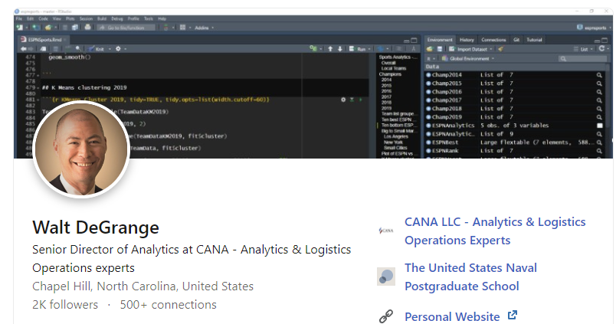
Let’s Connect!

Slide 7
Data Preparation
MORS CSAP
Tuesday, March 11, 2025
Walt DeGrange

Slide 8
Agenda
The Data
Instruction
Tidy Data
Instruction
Guided practice
Exploring Data with Traditional Excel
Instruction
Guided practice / check for understanding
Independent Practice & Assessment

Slide 9

Case Study National Parks
National park visitors by year
Data fields:
Year
National park name
Region
State
Visitors
Visit Type

Slide 10
What underlying issues impact this graph?
Annual Recreational Visits by Park Region

Slide 11

Common data issues
Improperly stored data
Duplicate records
Outliers
Missing data
Invalid entries

Slide 12
Tidy data
Each variable must have its own column
Each observation must have its own row
Each value must have its own cell
For Excel, this means the first row is the header / list of field names and each row underneath is a record / observation
No blank rows
No merged cells

Slide 13
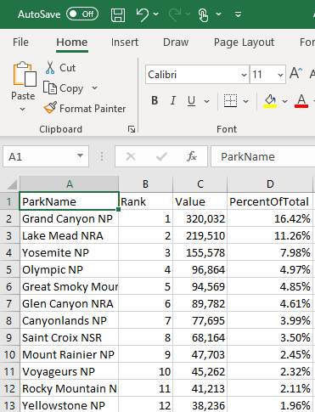
This data is tidy
Each variable has its own column
Each observation has its own row
Each value has its own cell

Slide 14
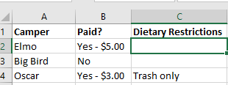
Tidy or untidy?

Slide 15
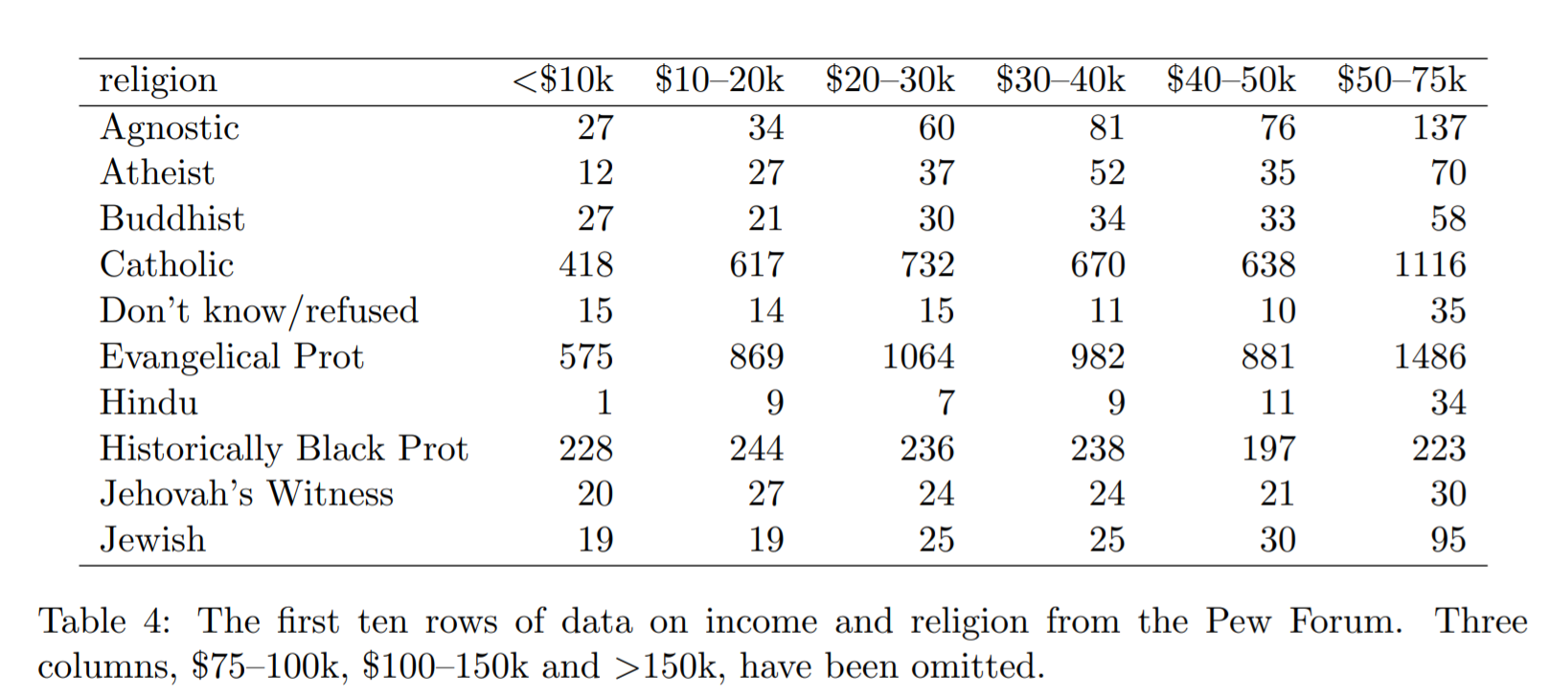
Tidy or untidy?
Wickham, H. (2014). Tidy Data. Journal of Statistical Software, 59(10), 1 - 23. doi:http://dx.doi.org/10.18637/jss.v059.i10
Notes:
Show the census data example

Slide 16
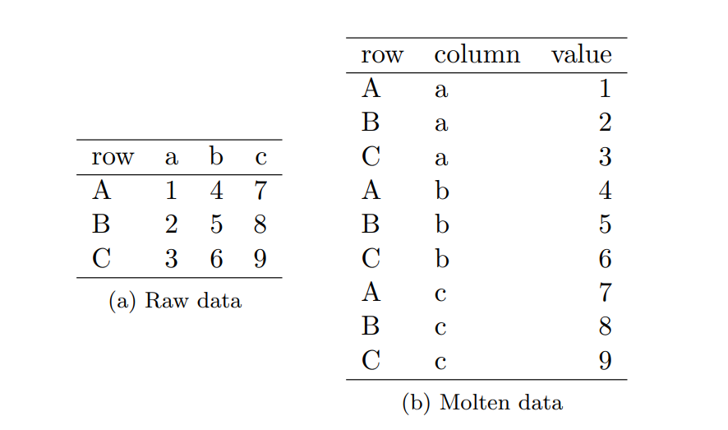
Wide to long
Wickham, H. (2014). Tidy Data. Journal of Statistical Software, 59(10), 1 - 23. doi:http://dx.doi.org/10.18637/jss.v059.i10
Notes:
Updated from same source – simpler to explain. In (a) the data is “messy” because there are variables in both rows and columns – this might be a good way to present it, but it is not a good way to prepare for analysis. (b) is exactly the same data presented in a “long” format. Each variable is in a column of its own. It is not a learning point, but this transformation technique is called “melting” the data and the result is a “molten” dataset.

Slide 17
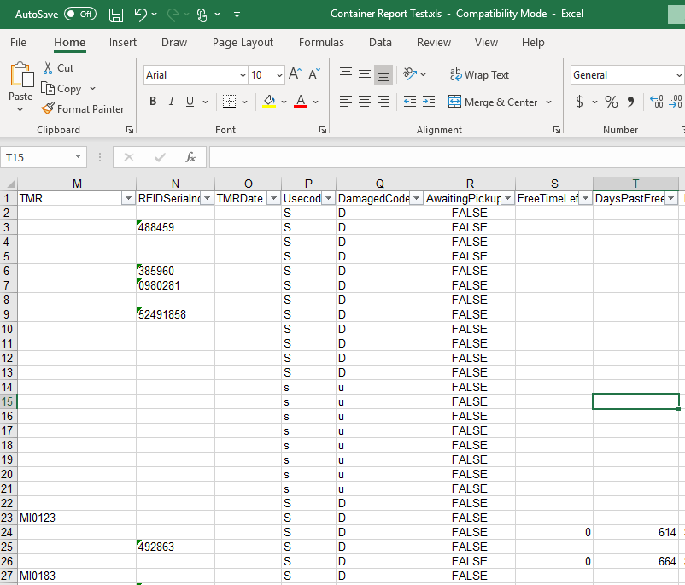
Check how your data is stored
Make sure numbers are properly stored as numbers, and that ID values & serial numbers are stored as text where appropriate

Slide 18
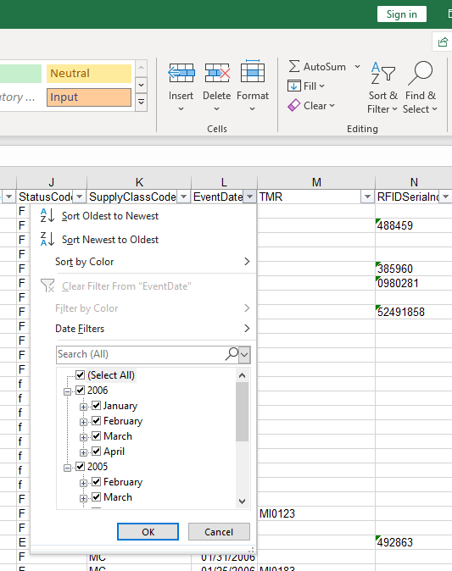
Data exploration
Get a sense of the range of values in a column with the Excel Sort & Filter tool

Slide 19
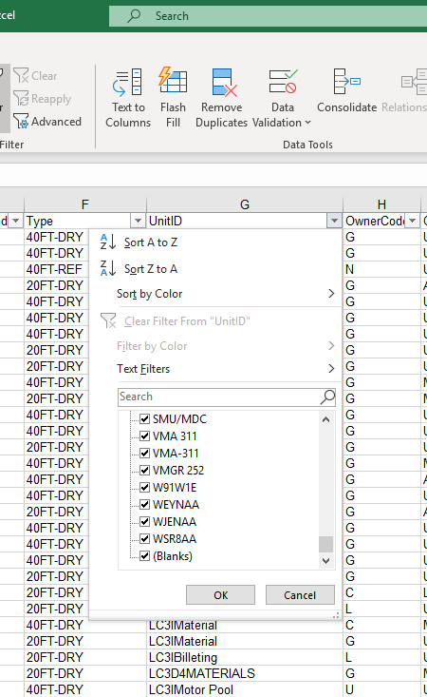
Data exploration
Sort & Filter also quickly identifies presence of missing values and invalid levels in categorical data

Slide 20
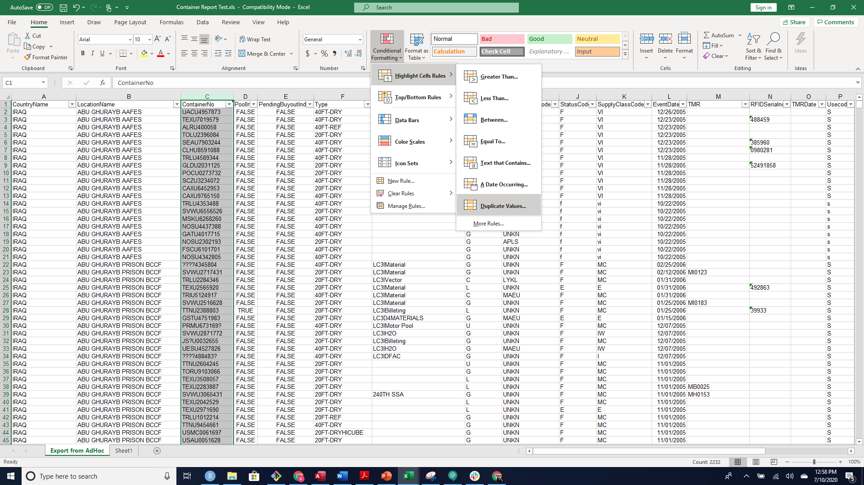
Conditional formatting
Quickly scan for duplicated primary keys
Primary keys should uniquely identify a record

Slide 21
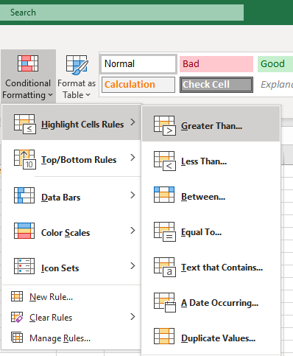
Data exploration
Highlight outliers and invalid numeric entries with conditional formatting

Slide 22
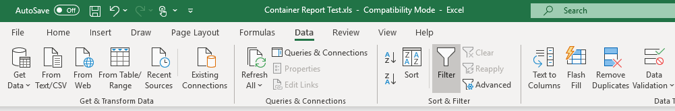
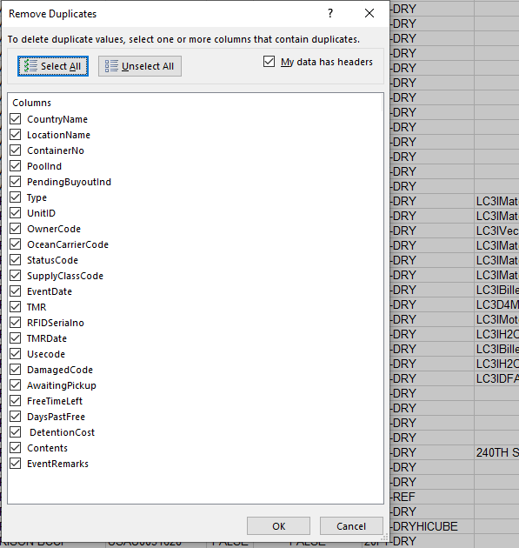
Remove duplicates
Quickly remove duplicates with Excel’s ‘Remove Duplicates’ tool

Slide 23

Functions to summarize data with Format as Table
SUM()
COUNTA()
MIN()
MAX()
Range: Max()-Min()
AVERAGE()
MEDIAN()
MODE()
VAR()
STDEV()
Notes:
For long course, briefly explain and demonstrate each function.

Slide 24
Learn More
Alexander, M., Kusleika, R. and Walkenbach, J. Excel 2019 Bible. Wiley Press. 2018.
Wickham, Hadley. Tidy data. Journal of Statistical Software 59.10 (2014): 1-23.

